Slide 1
Data Wrangling and Data Analysis
Exploratory Data Analysis
Daniel L. Oberski & Erik-Jan van Kesteren
Department of Methodology & Statistics
Utrecht University

Slide 2
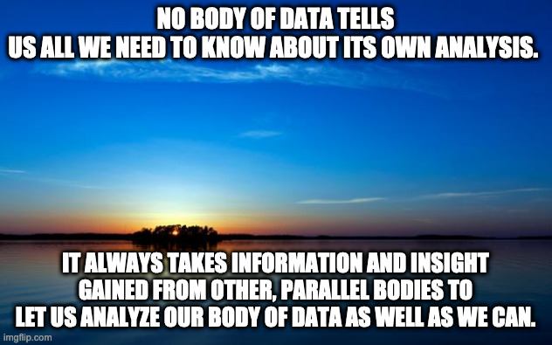
“NO BODY OF DATA TELLS US ALL we need to know ABOUT ITS OWN ANALYSIS. It always takes information and insight gained from other, parallel bodies to let us analyze our body of data as well as we can. (If we don't have it, we do as well as we can.)” – EDA p. 115
- John Tukey 1970, EDA

Slide 3
This week
Data visualization principles
The grammar of graphics
Exploratory data analysis (EDA)
Goal of the week: know how to create and improve data visualizations, and know how to use them for exploration

Slide 4

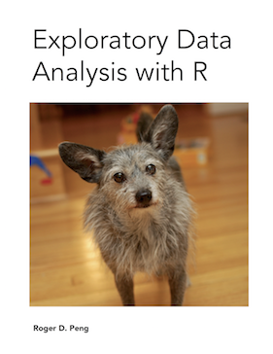
Reading materials for this week
R for Data Science (R4DS)
(Wickham & Grolemund 2017(ish) )
https://r4ds.had.co.nz
Chapters 3,5, 7
Optional:
Exploratory Data Analysis with R (Peng 2020)
https://bookdown.org/rdpeng/exdata/

Slide 5
Assignments this week
Monday: Tidy data visualization with dplyr and ggplot
Tuesday: Exploratory data analysis
Thursday: either (a) resit for the test, or (b) assignment on advanced data visualization

Slide 6
Exploratory vs. confirmatory

Slide 7
Exploratory vs confirmatory
Exploratory analysis
Generate new insights
Create new hypotheses
Analysis may depend on data
Confirmatory analysis
Test theory
A priori hypothesis
Analysis predefined
Example: registered report

Slide 8
Exploratory vs confirmatory
You work at Google and your colleague has implemented a new search algorithm for German searches. Your task is to check whether this algorithm performs better than the existing one.
Confirmatory.
Theory testing, hypothesis: new works better than old
Analysis can be defined in advance: which outcome variables, how to sample from the population, which method?
Full analysis script could be written before the data even exists

Slide 9
Exploratory vs confirmatory
You have obtained access to your company’s customer relations database. Your task is to find data-driven ways in which your company can improve customer retainment.
Exploratory.
Generate new insights - at which touchpoint do customers drop out?
Create new hypotheses - there may be two types of customers who drop out
Analysis cannot be defined in advance, task is to explore associations between features

Slide 10
Exploratory vs confirmatory
Both are necessary and complementary
Typical scientific questions: exploratory -> confirmatory
Then build on the tested theories to generate new insights: confirmatory -> exploratory?
This lecture: exploratory analysis

Slide 11



Slide 12
Some good advice on data exploration

Slide 13
Peng’s EDA checklist
Formulate your question
Read in your data
Check the packaging, (run str())
Look at the top and the bottom of your data
Check your “n”s
Validate with at least one external data source
Try the easy solution first
Challenge your solution
Follow up

Slide 14
Tukey’s approach to EDA
Look at center and spread
Find comparisons
“Straightening and flattening”:
Use logarithms and other transforms
Use models and residuals

Slide 15
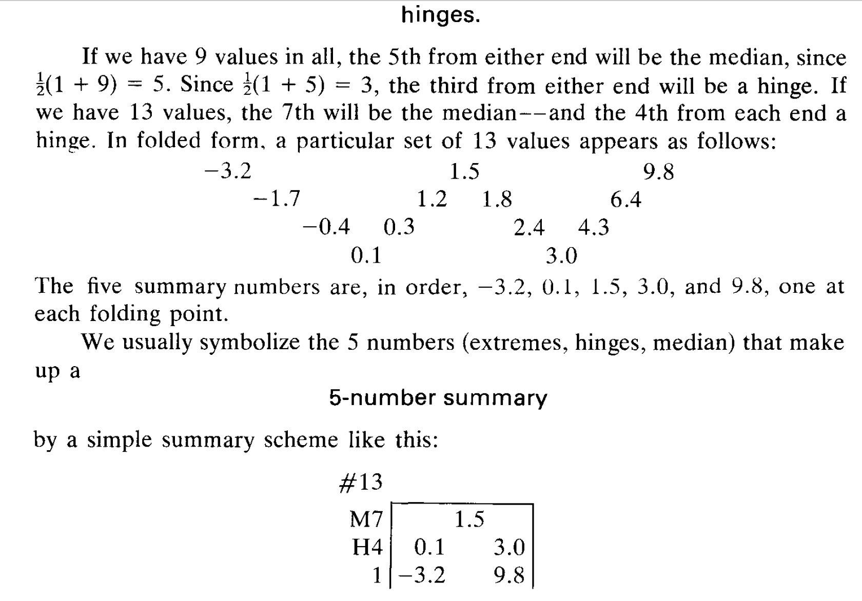
(Tukey 1970)

Slide 16
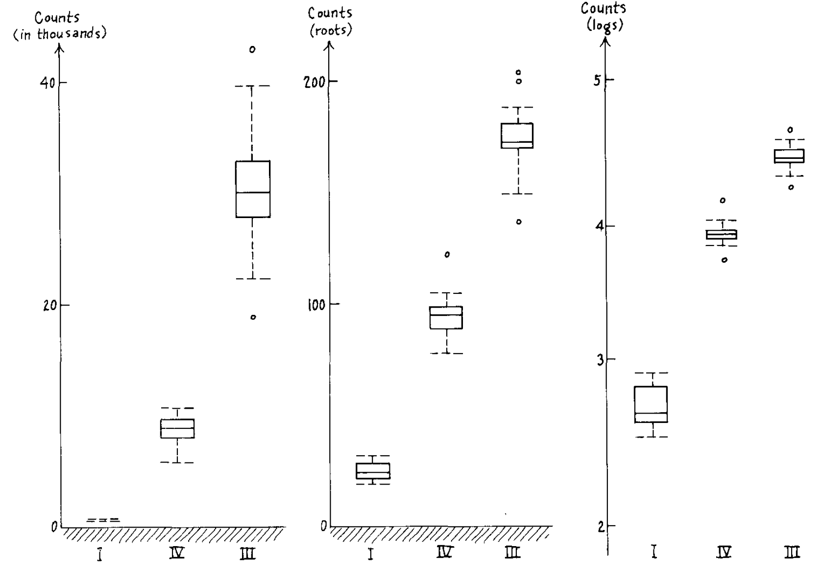
Spread vs. location
(Tukey 1970)

Slide 17
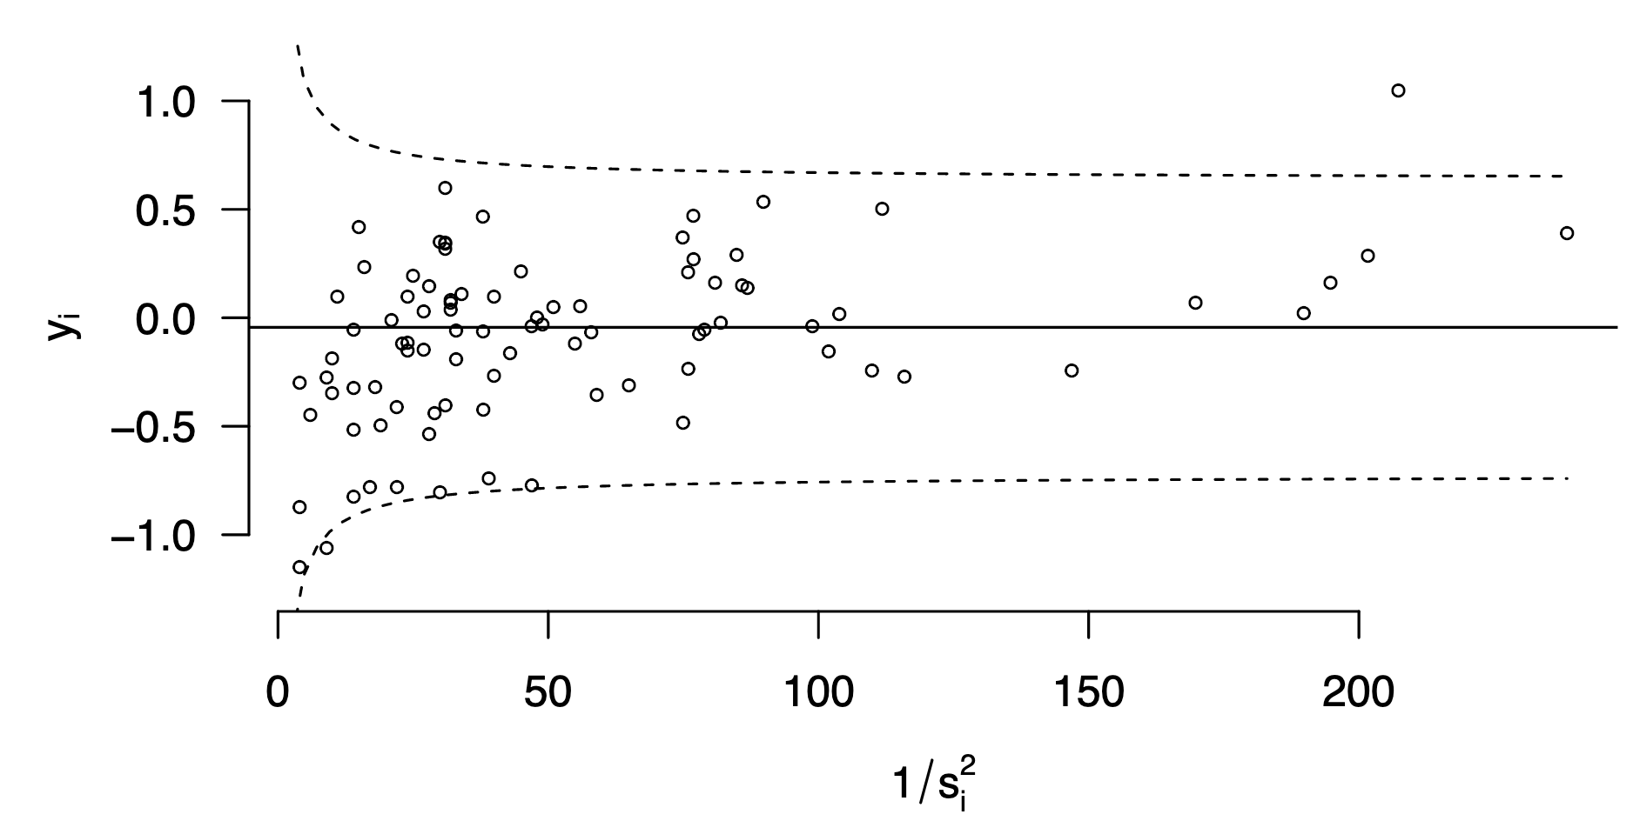
Adverse events in Dutch hospitals (Lenz & Oberski)

Slide 18
Example exploration of current corona cases in the Netherlands

Slide 19

https://github.com/J535D165/CoronaWatchNL

Slide 20
Read data, check packaging
url_icu <- "https://raw.githubusercontent.com/J535D165/CoronaWatchNL/master/data-ic/data-nice/NICE_IC_long_latest.csv"
icu <- read_csv(url_icu)
> dim(icu)
[1] 1935 3

Slide 21
Look at top and bottom
> icu %>% tail
# A tibble: 6 x 3
Datum Type Aantal
<date> <chr> <dbl>
1 2020-09-28 Toename ontslag (ziekenhuis) 0
2 2020-09-28 Totaal opnamen (IC) 144
3 2020-09-28 Toename opnamen (IC) 7
4 2020-09-28 Totaal ontslag (IC) 56
5 2020-09-28 Cumulatief opnamen (IC) 3261
6 2020-09-28 Toename ontslag (overleden) 0

Slide 22
Look at top and bottom
> icu %>% head
# A tibble: 6 x 3
Datum Type Aantal
<date> <chr> <dbl>
1 2020-02-27 Totaal ingezette IC's 5
2 2020-02-27 Cumulatief opnamen (IC) 7
3 2020-02-27 Totaal ontslag (IC) 0
4 2020-02-27 Cumulatief ontslag (ziekenhuis) 0
5 2020-02-27 Cumulatief ontslag (overleden) 0
6 2020-02-27 Toename ontslag (overleden) 0

Slide 23
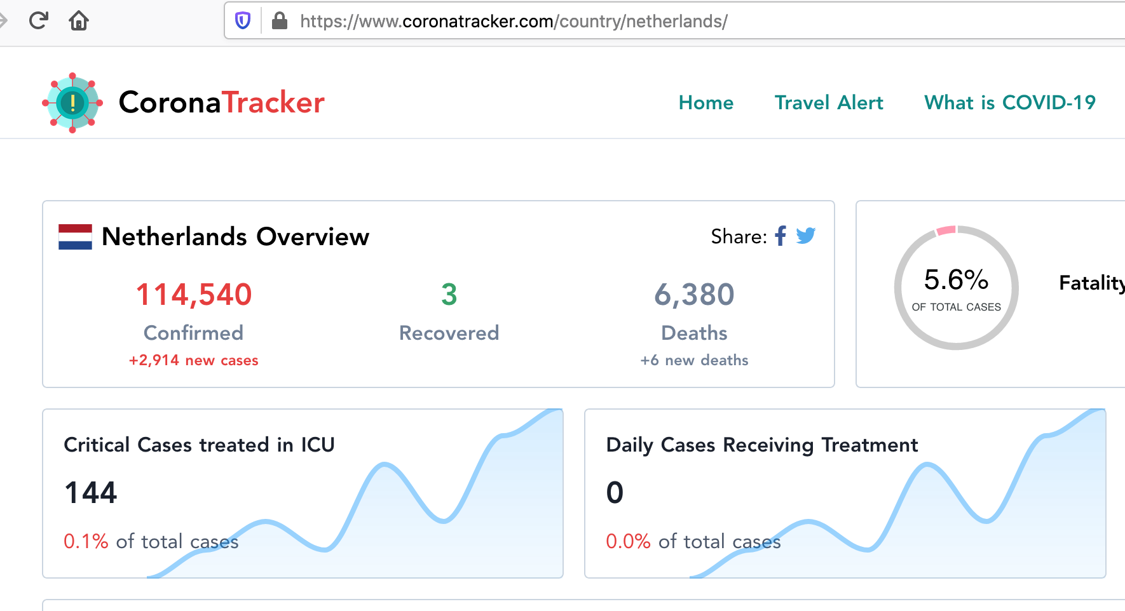
Validate with external source

Slide 24
Check n’s
> icu %>% group_by(Type) %>% summarize(n())
# A tibble: 9 x 2
Type `n()`
<chr> <int>
1 Cumulatief ontslag (overleden) 215
2 Cumulatief ontslag (ziekenhuis) 215
3 Cumulatief opnamen (IC) 215
4 Toename ontslag (overleden) 215
5 Toename ontslag (ziekenhuis) 215
6 Toename opnamen (IC) 215
7 Totaal ingezette IC's 215
8 Totaal ontslag (IC) 215
9 Totaal opnamen (IC) 215

Slide 25
icu %>%
filter(Type == "Totaal opnamen (IC)") %>%
ggplot(aes(Datum, Aantal)) + geom_line() +
theme_fira()

Slide 26
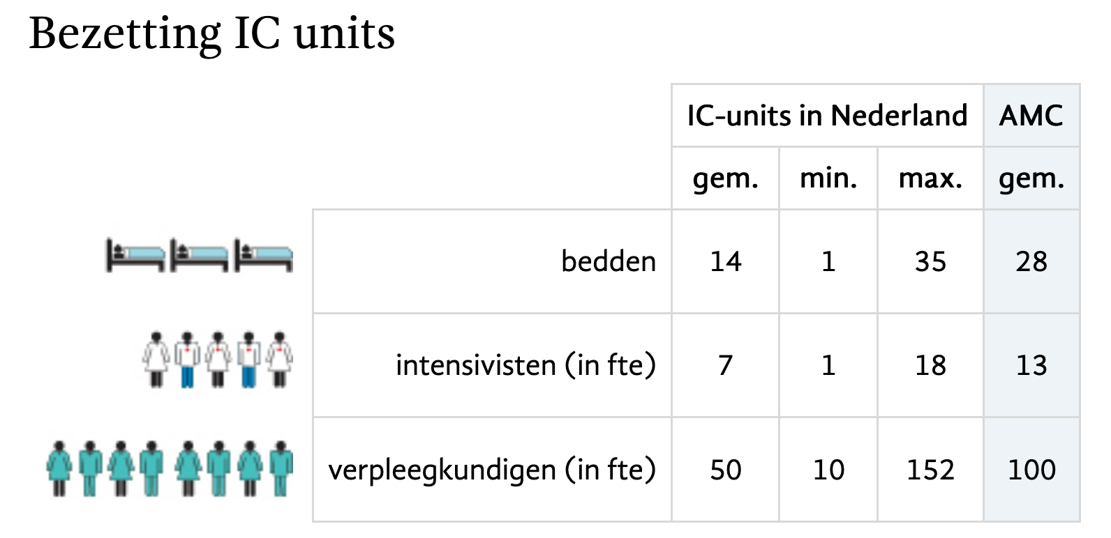
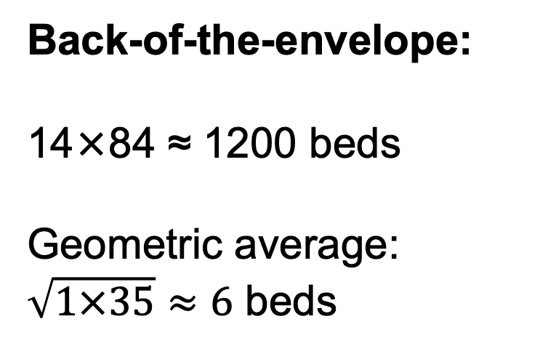
Understand what you’re looking at
(84 ICUs)
Back-of-the-envelope:
14×84 ≈ 1200 beds
Geometric average:
$\sqrt{1×35}≈6$ beds

Slide 27
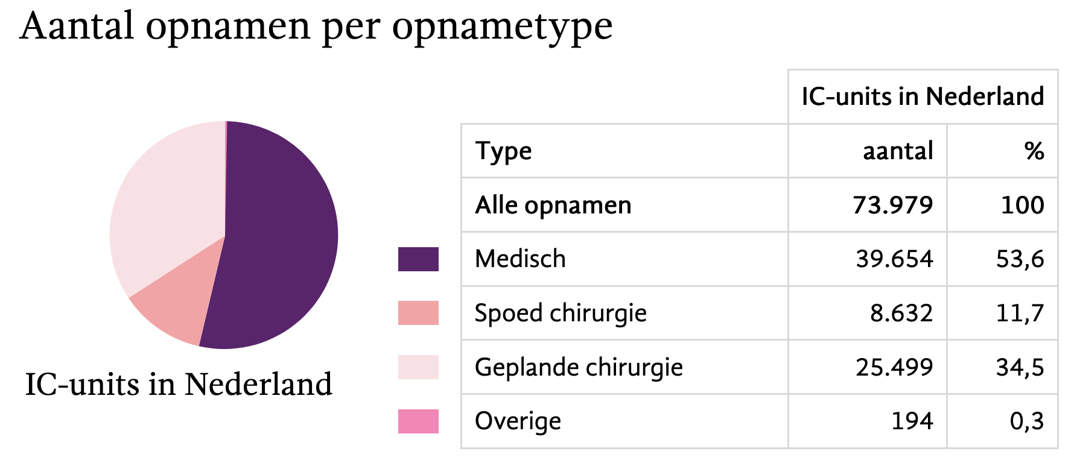
Understand what you’re looking at

Slide 28
icu %>%
filter(Type == "Totaal opnamen (IC)") %>%
ggplot(aes(Datum, Aantal)) + geom_line() +
theme_fira() + scale_y_log10()

Slide 29
url_sewage <- "https://raw.githubusercontent.com/J535D165/CoronaWatchNL/master/data-dashboard/data-sewage/RIVM_NL_sewage_counts.csv"
sewage <- read_csv(url_sewage)
joined <- bind_rows(sewage, icu)

Slide 30
joined %>%
filter(Type == "Totaal opnamen (IC)" |
Type == "Virusdeeltjes per ml rioolwater") %>%
ggplot(aes(Datum, Aantal, color = Type)) + geom_line() +
scale_y_log10() +
theme_fira() + scale_color_brewer(type = "qual")

Slide 31
joined_wide <- joined %>%
filter(Type == "Totaal opnamen (IC)" |
Type == "Virusdeeltjes per ml rioolwater") %>%
pivot_wider(names_from = Type, values_from = Aantal)

Slide 32
joined_wide %>%
ggplot(aes(`Virusdeeltjes per ml rioolwater`, `Totaal opnamen (IC)`)) +
geom_point() + theme_fira()

Slide 33
joined_wide %>%
ggplot(aes(`Virusdeeltjes per ml rioolwater`, `Totaal opnamen (IC)`)) +
geom_point() + scale_y_log10() + scale_x_log10() + theme_fira()
“straightening”
Notes:
“straightening”

Slide 34
joined_wide %>%
ggplot(aes(`Virusdeeltjes per ml rioolwater`, `Totaal opnamen (IC)`)) +
geom_point() + geom_smooth() +
scale_y_log10() + scale_x_log10() + theme_fira()

Slide 35
joined_wide %>%
ggplot(aes(`Virusdeeltjes per ml rioolwater`, `Totaal opnamen (IC)`)) +
geom_point() + geom_smooth(method = “lm”) +
scale_y_log10() + scale_x_log10() + theme_fira()

Slide 36
Looking at residuals
joined_wide <- joined_wide %>%
mutate(
log_icu = log(`Totaal opnamen (IC)` + 1),
log_sewage = log(`Virusdeeltjes per ml rioolwater` + 1))
fit_lm <- lm(log_icu ~ log_sewage, data = joined_wide)
joined_wide <- joined_wide %>%
mutate(log_icu_predicted = predict(fit_lm, newdata = .),
log_icu_residual = log_icu - log_icu_predicted)

Slide 37
joined_wide %>%
filter(!is.na(log_icu_residual)) %>%
ggplot(aes(Datum, log_icu_residual)) +
geom_line() + theme_fira()
“flattening”

Slide 38
joined_wide %>%
filter(!is.na(log_icu_residual)) %>%
ggplot(aes(Datum, log_icu_residual)) +
geom_line() + geom_smooth() + theme_fira()
“flattening”

Slide 39
Using some standard plots for EDA

Slide 40
Visual EDA: two questions
Variation: How are the features distributed?
Univariate
Specific: among people, among time, among flights
General: among the unit of measurement, among examples
In tabular data, generally one example/unit per row
Association: What type of covariation occurs in the data?
Which features covary? When A is high, B is high?
Multidimensional, multivariate.

Slide 41
Visual EDA: two questions
Variation: How are the features distributed?
Univariate
Specific: among people, among time, among flights
General: among the unit of measurement, among examples
In tabular data, generally one example/unit per row
Association: What type of covariation occurs in the data?
Which features covary? When A is high, B is high?
Multidimensional, multivariate.

Slide 42
library(nycflights13)
flights
#> # A tibble: 336,776 x 19
#> year month day dep_time sched_dep_time dep_delay arr_time sched_arr_time
#> <int> <int> <int> <int> <int> <dbl> <int> <int>
#> 1 2013 1 1 517 515 2 830 819
#> 2 2013 1 1 533 529 4 850 830
#> 3 2013 1 1 542 540 2 923 850
#> 4 2013 1 1 544 545 -1 1004 1022
#> 5 2013 1 1 554 600 -6 812 837
#> 6 2013 1 1 554 558 -4 740 728
#> # … with 3.368e+05 more rows, and 11 more variables: arr_delay <dbl>,
#> # carrier <chr>, flight <int>, tailnum <chr>, origin <chr>, dest <chr>,
#> # air_time <dbl>, distance <dbl>, hour <dbl>, minute <dbl>, time_hour <dttm>

Slide 43
Bar chart
X position: feature of interest
Y position: count of occurrences (statistical transformation)
Geom: bars/rectangle
For categorical features e.g., flight origin

Slide 44
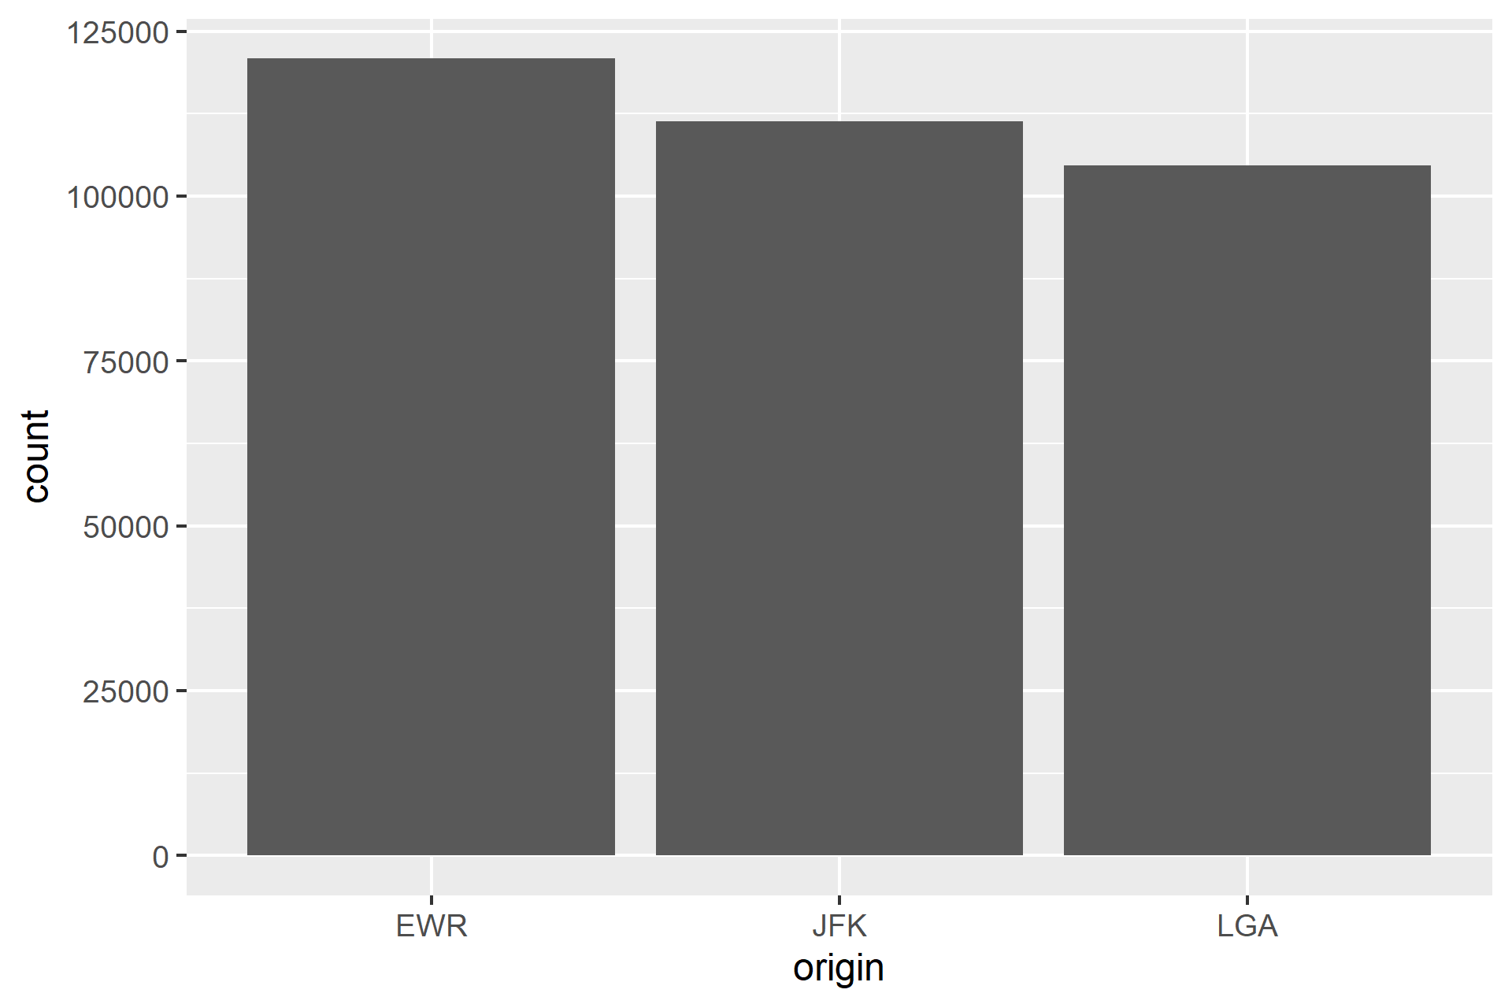
Bar chart
ggplot(data = flights) +
geom_bar(mapping = aes(x = origin))

Slide 45
Bar chart
Fewest flights depart from LGA
Almost 125000 flights from EWR

Slide 46
Histogram
X position: feature of interest
Y position: count of occurrences in bins (statistical transformation)
Geom: bars/rectangle
For continuous features, e.g., departure delay in minutes

Slide 47
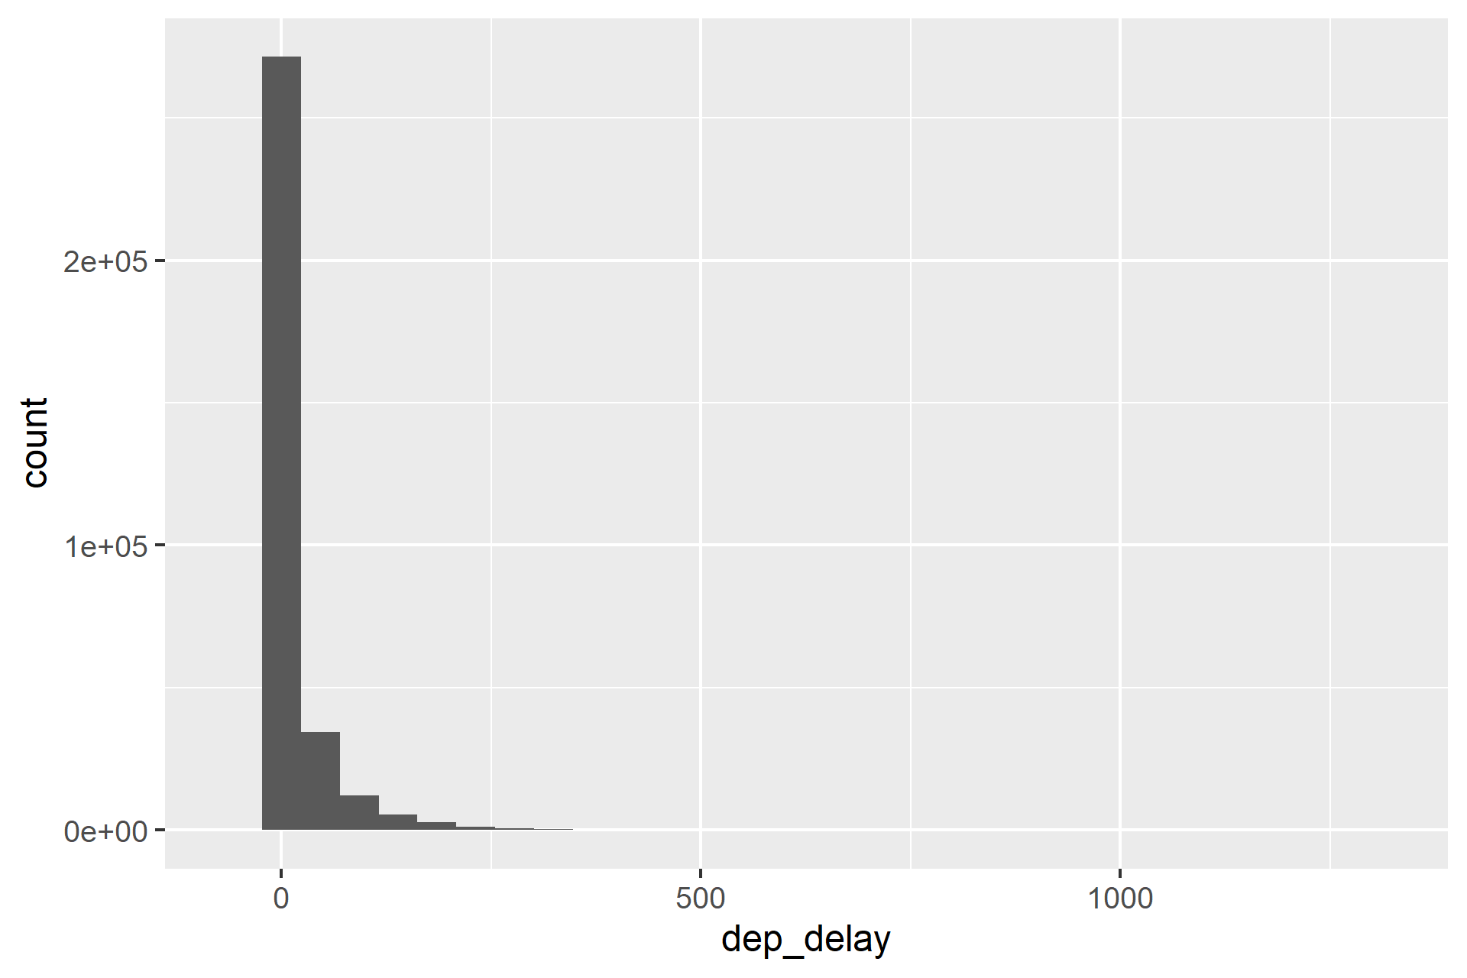
Histogram
ggplot(data = flights) +
geom_histogram(mapping = aes(x = dep_delay))

Slide 48
Histogram
New question: why the strange distribution? What happens at the tail end?

Slide 49
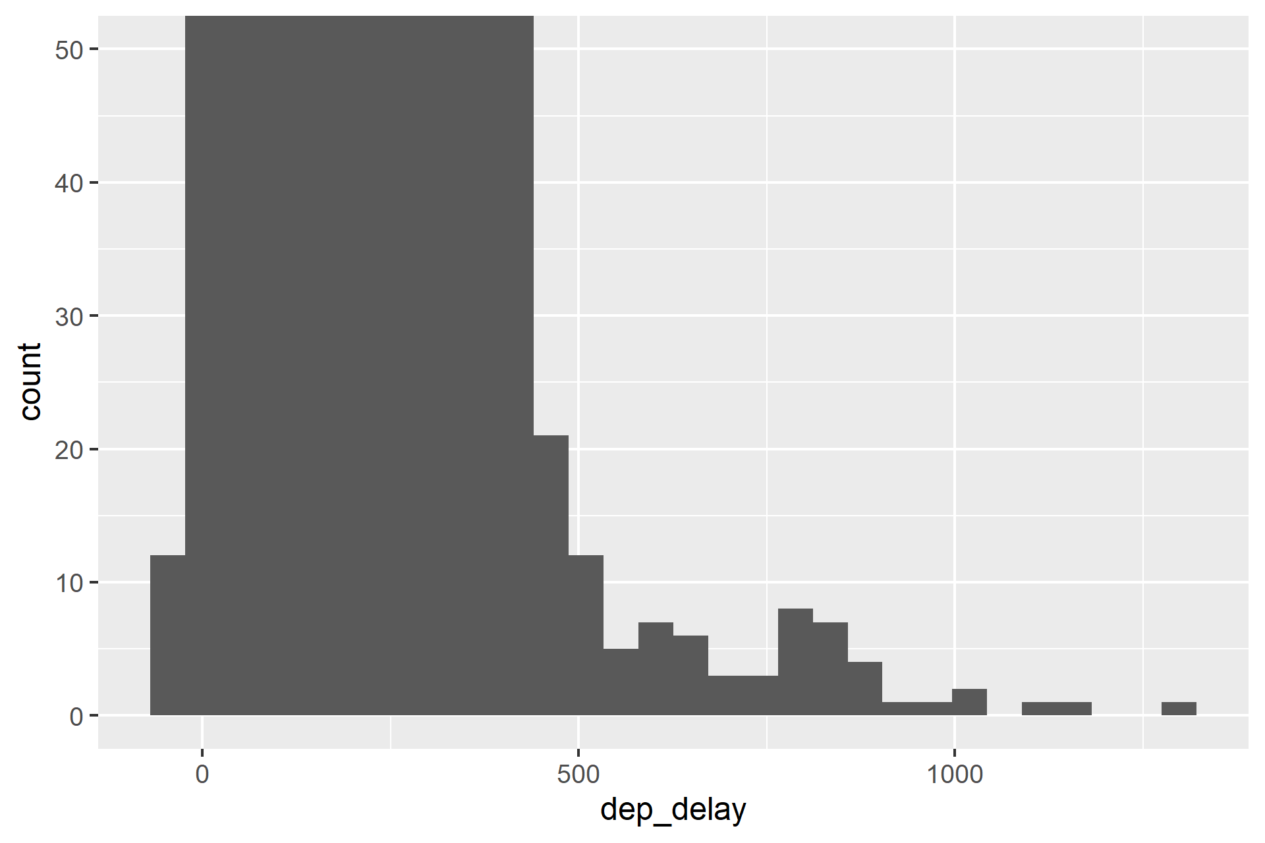
Histogram (zoomed)
ggplot(data = flights) +
geom_histogram(mapping = aes(x = dep_delay)) +
coord_cartesian(ylim = c(0, 50))
That’s a long delay!

Slide 50
Histogram
Most flights are approximately on time
There are even some flights that depart early
There are a few flights with more than 1000 minutes delay

Slide 51
Density
X position: feature of interest
Y position: density (statistical transformation, smoothed histogram)
Geom: polygon / line
For continuous features, e.g., airtime in minutes

Slide 52
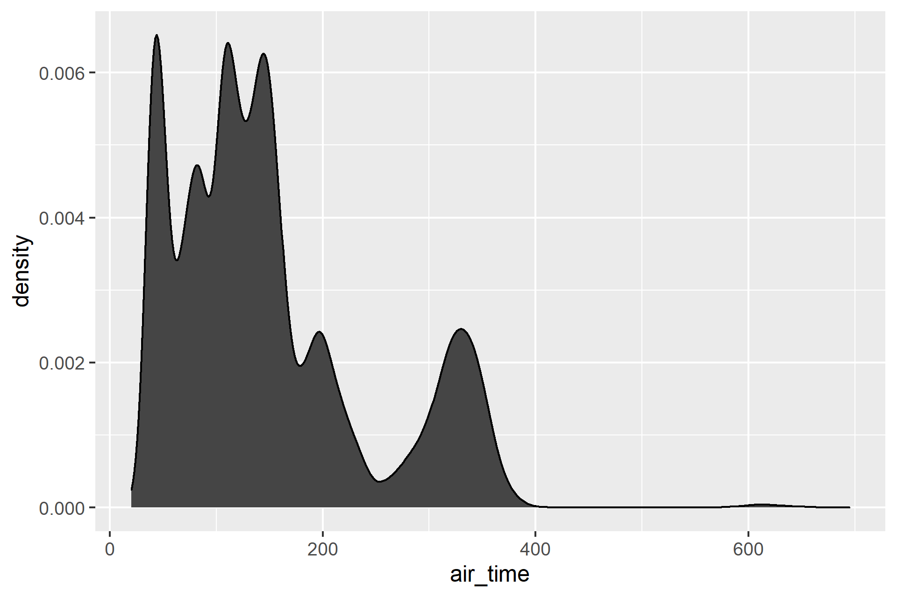
Density
ggplot(data = flights) +
geom_density(mapping = aes(x = air_time))

Slide 53
Density
Most flights from NY are under 200 minutes (3.3 hours)
Few flights are between 200 and 250 minutes
Quite some flights are between 250 and 400 minutes
Some flights are over 600 minutes (weird bump? Remember!)
Air times are not normally distributed!

Slide 54
Visual EDA: two questions
Variation: How are the features distributed?
Univariate
Specific: among people, among time, among flights
General: among the unit of measurement, among examples
In tabular data, generally one example/unit per row
Association: What type of covariation occurs in the data?
Which features covary? When A is high, B is high?
Multidimensional, multivariate.

Slide 55
Scatter plot
X position: feature A of interest (in regression, generally predictor)
Y position: feature B of interest (in regression, outcome)
Geom: points/dots
For continuous features, e.g., departure delay in minutes and arrival delay in minutes

Slide 56
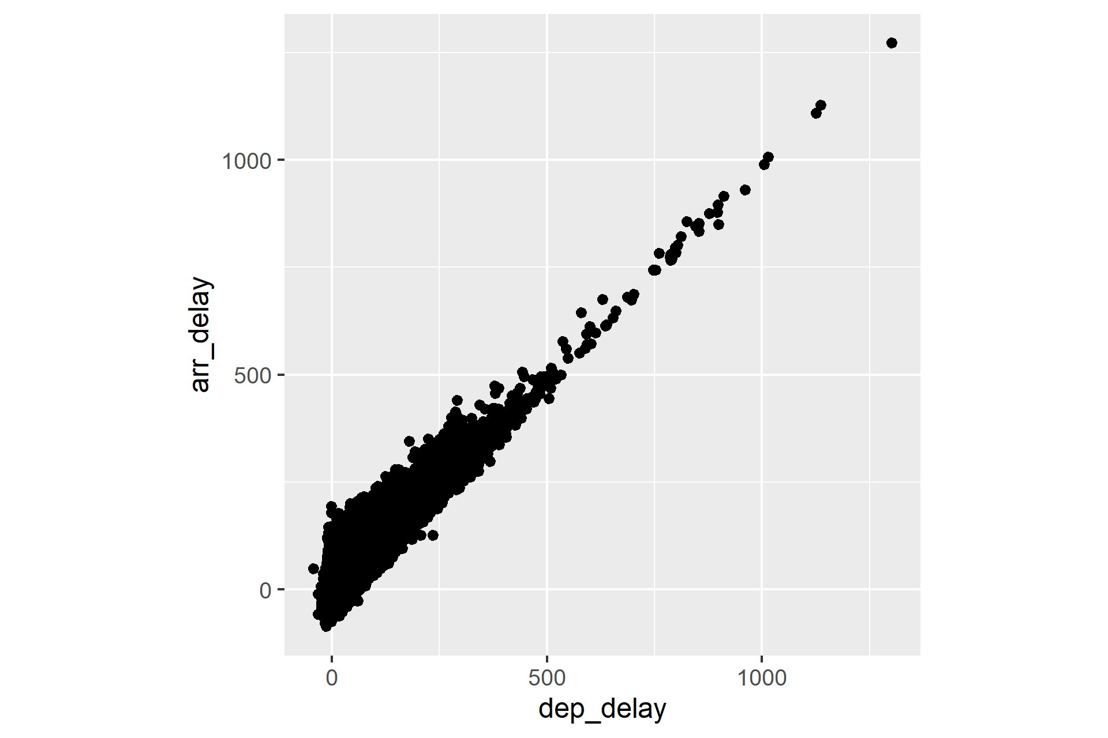
Scatter plot
ggplot(data = flights) +
geom_point(aes(x = dep_delay, y = arr_delay))

Slide 57
Scatter plot
Departure and arrival delay correlate strongly
Arrival delay is generally higher than departure delay
Only a few delays are above 500 minutes

Slide 58
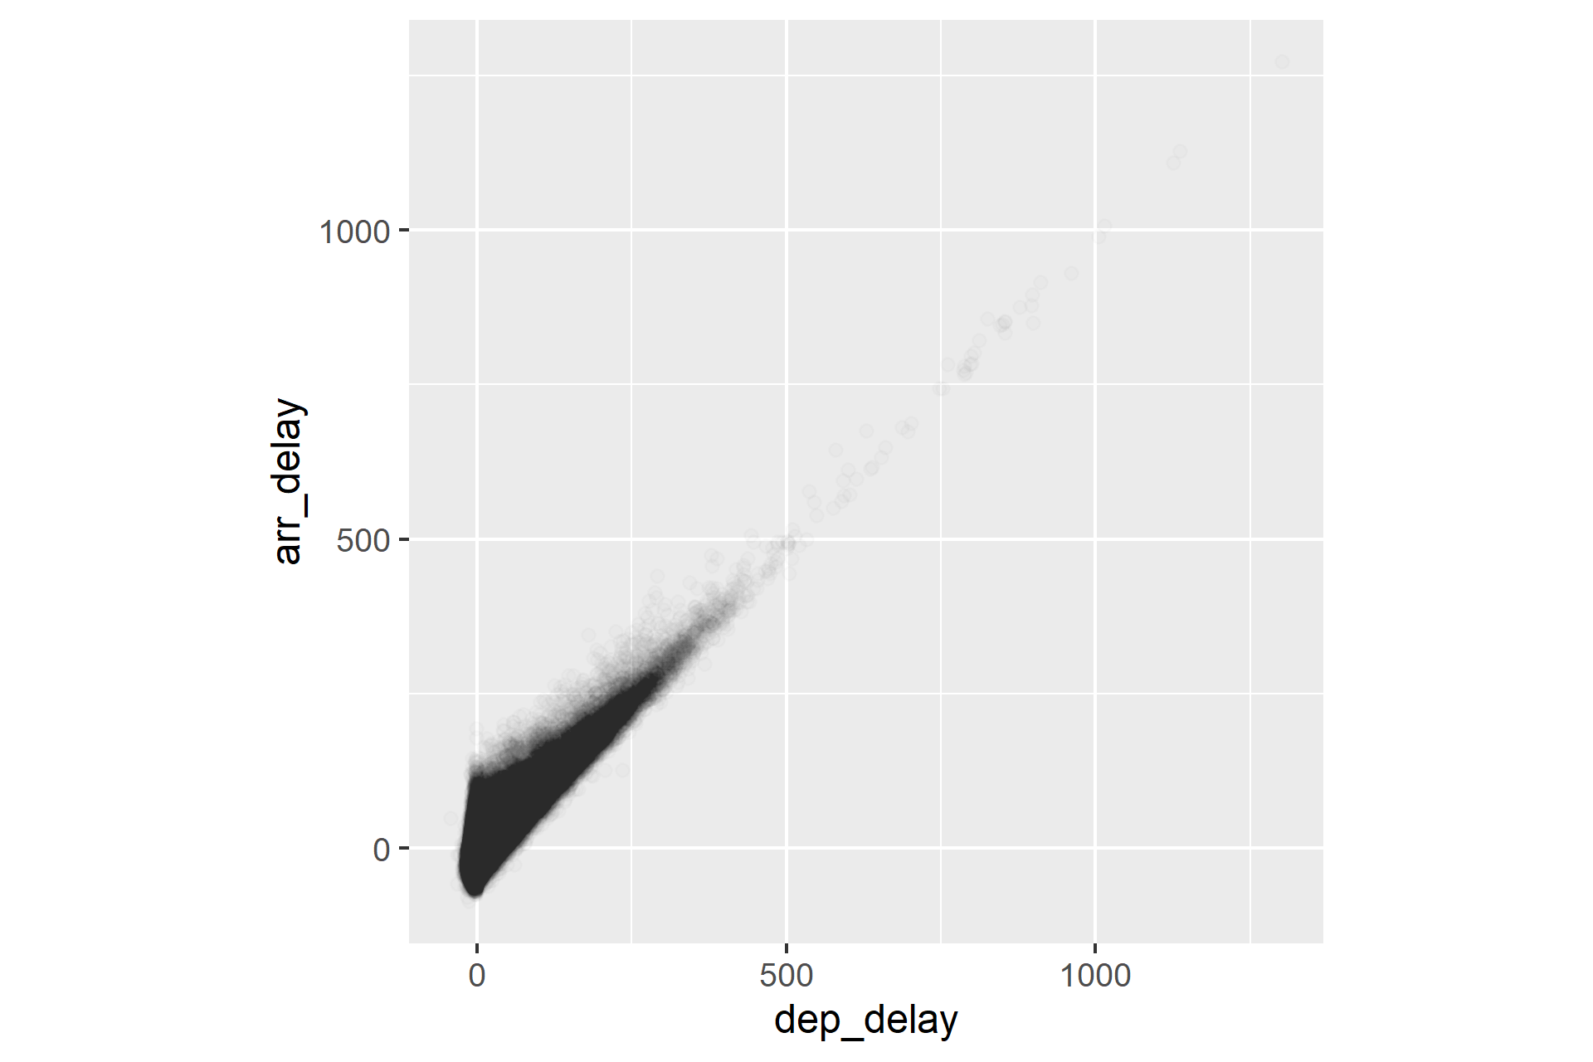
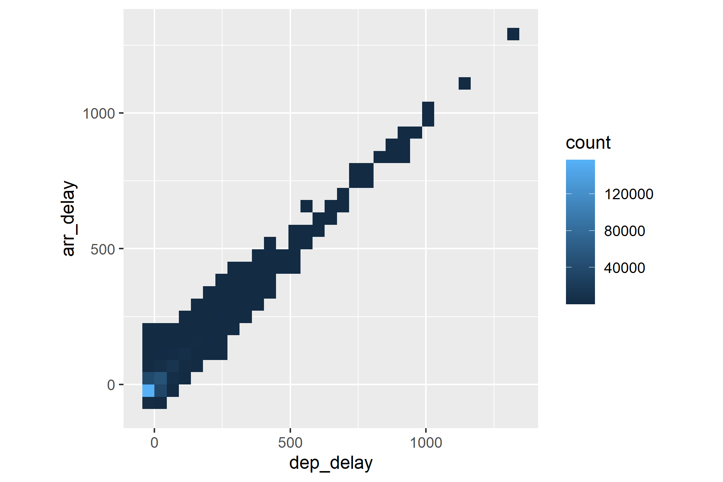
Solutions to overplotting
Transparency (alpha) or binning (geom_bin2d)

Slide 59
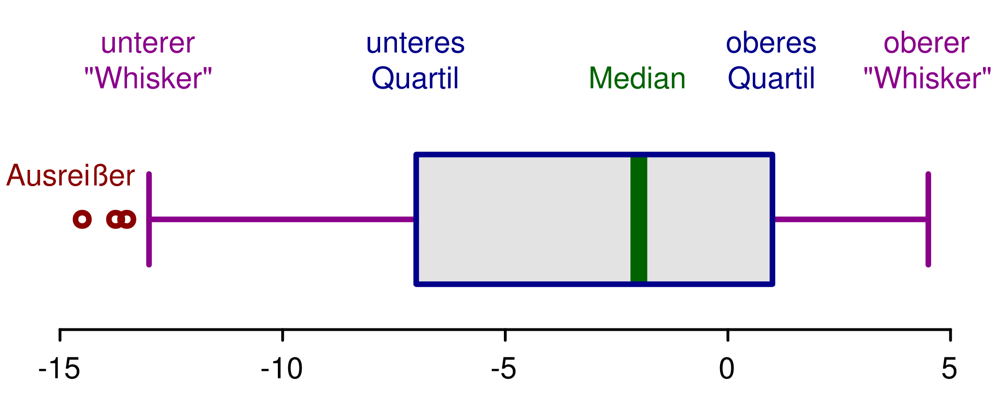
Box plot (Tukey)
X position: feature A of interest
Y position: feature B of interest
Geom: rectangles for box, lines (whiskers), points for outliers
Statistical transformations:
median, 25% and 75% percentile
(inter quartile range, IQR),
1.5×IQR for “whiskers”
Continuous vs. categorical, e.g., origin and airtime

Slide 60
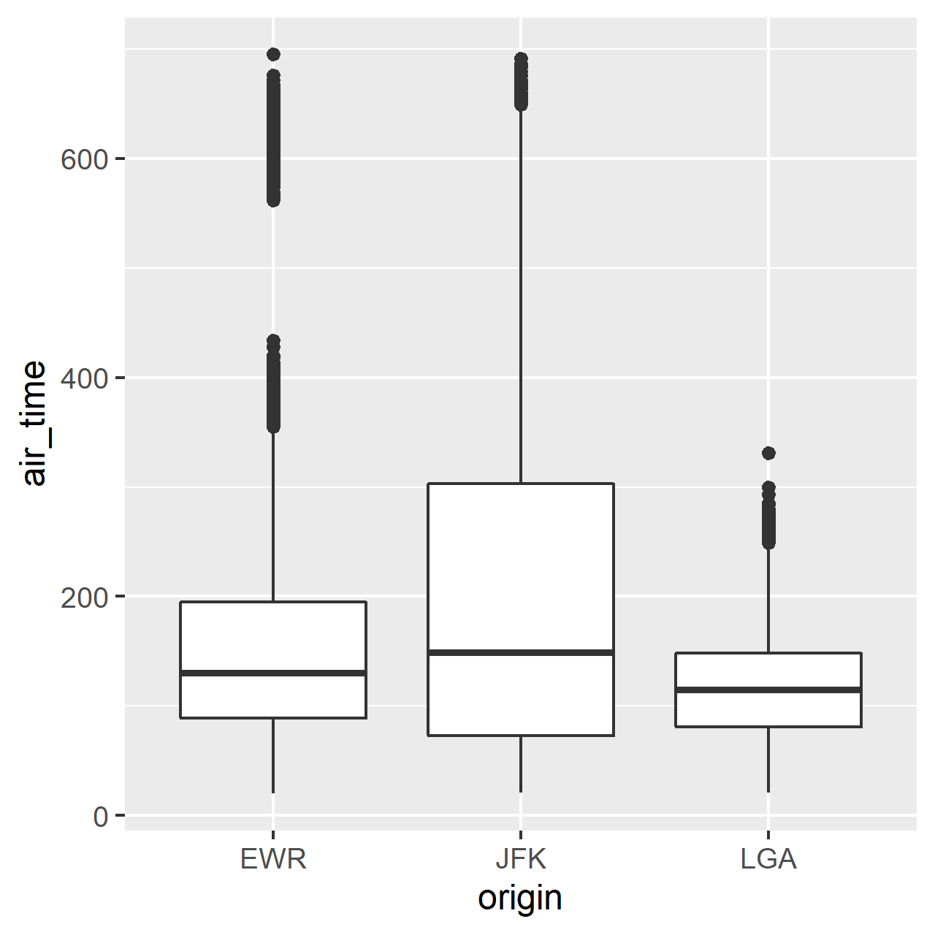
Box plot
ggplot(data = flights) +
geom_boxplot(aes(x = origin, y = air_time))

Slide 61
Box plot
Flights from LGA do not have the >600 minute bump
Flights from JFK take longest, on average (median)
Flight times from JFK have largest IQR
Let’s look at destination rather than origin?

Slide 62
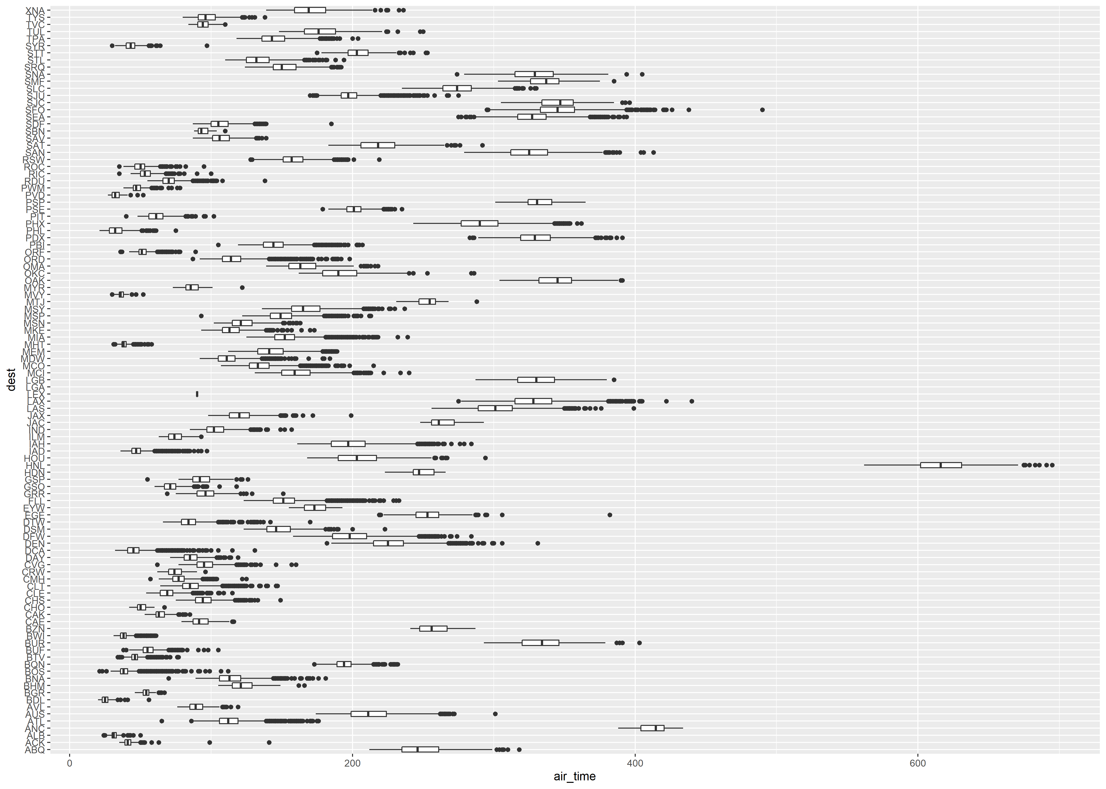
Box plot by destination
Our >600min
bump from earlier:
Honolulu airport!

Slide 63
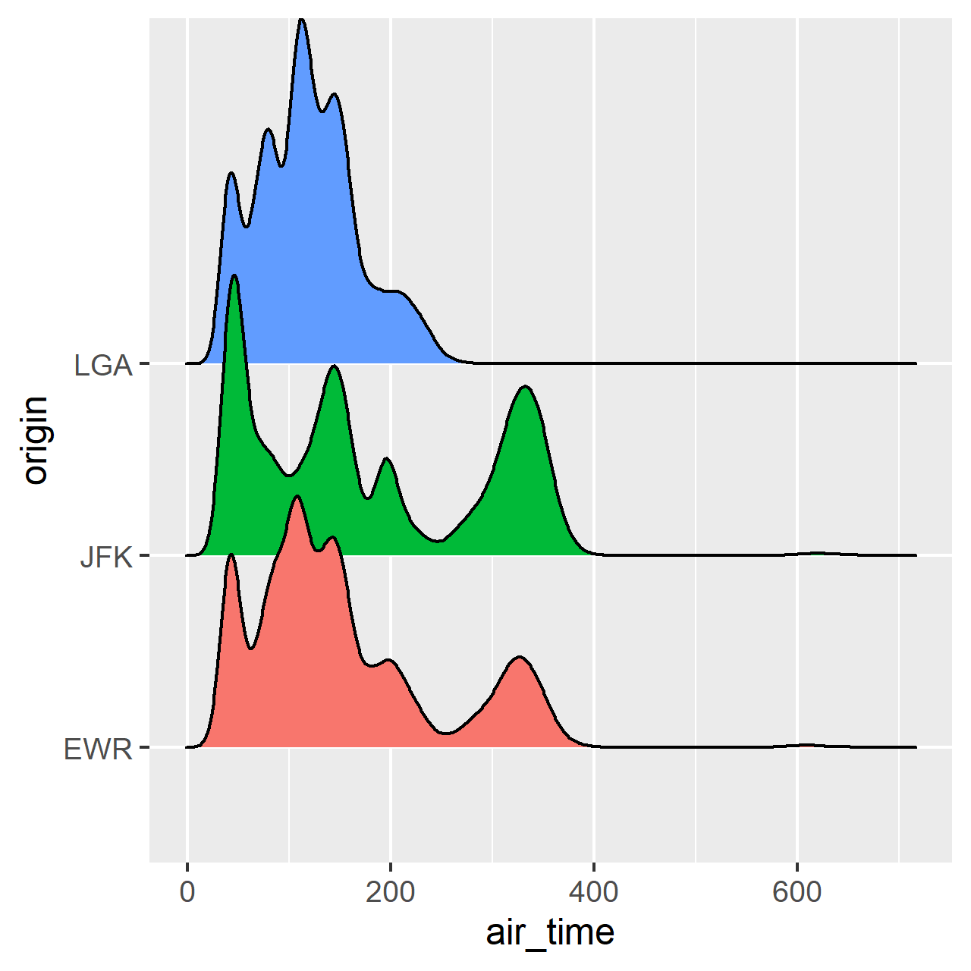
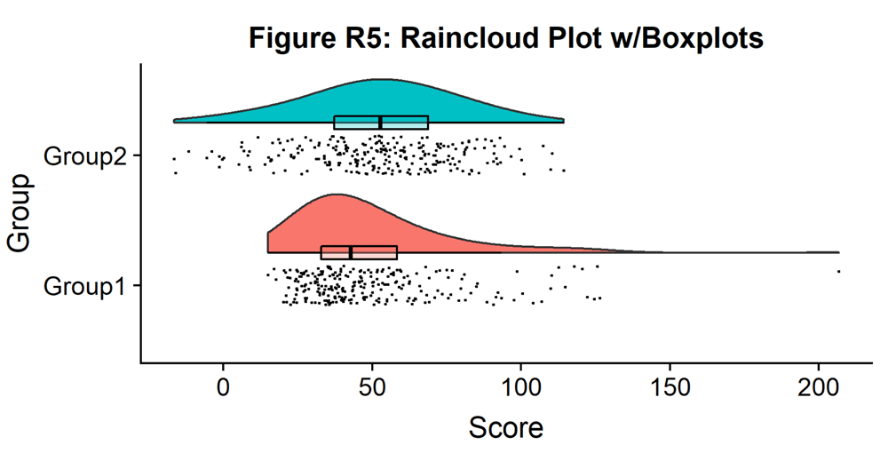
Many options available for categorical vs continuous
ggridges (ridgeline plot)
Raincloud plot

Slide 64
Facets
Faceting a plot means creating a subplot per category
Also called “small multiples” (tufte)
Allows for another categorical variable in the visualisation
Danger: clutter
+ facet_wrap(~feature)

Slide 65
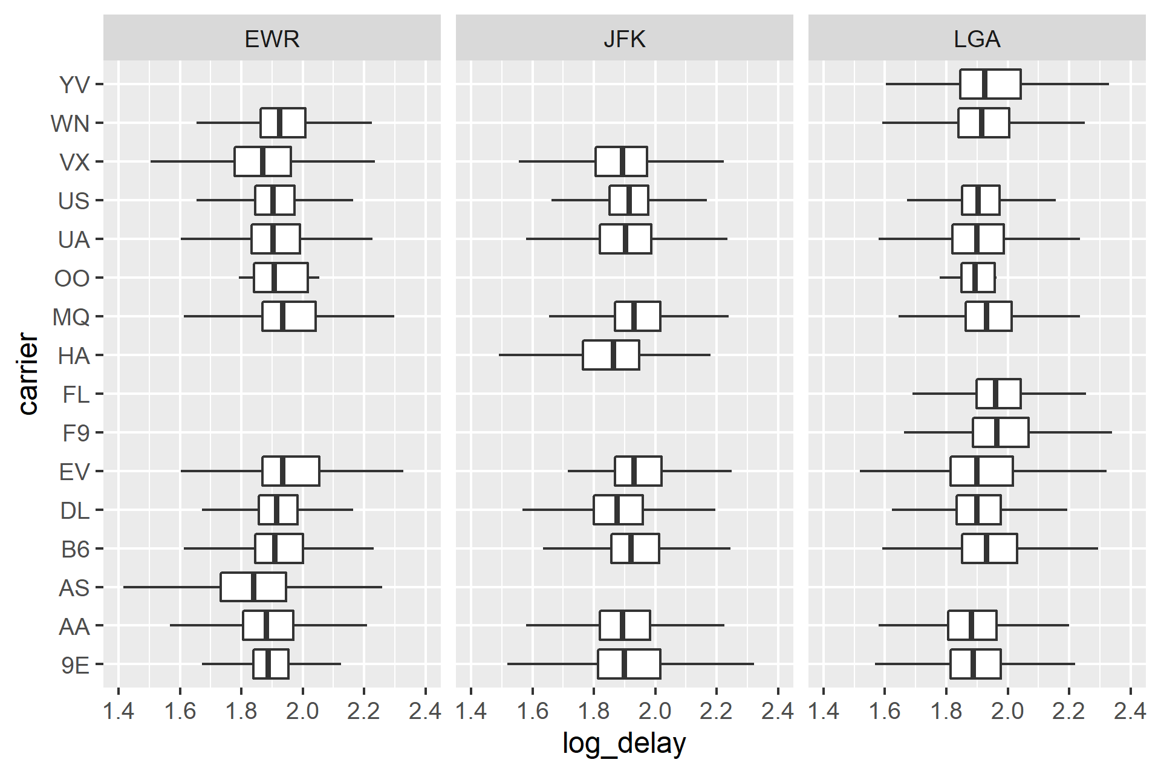
Boxplot of (log) delay by carrier, faceted by origin

Slide 66
Facets
Some carriers do not fly from some airports (missing data)
Delays are quite similar across origin airports and carriers

Slide 67
Pairs plot
Pairs plot: a scatter plot for each variable
Multivariate
Difficult in ggplot: facet by variable (not a feature in the original dataset)
Data frame needs to be
Package available: GGally (ggpairs)

Slide 68
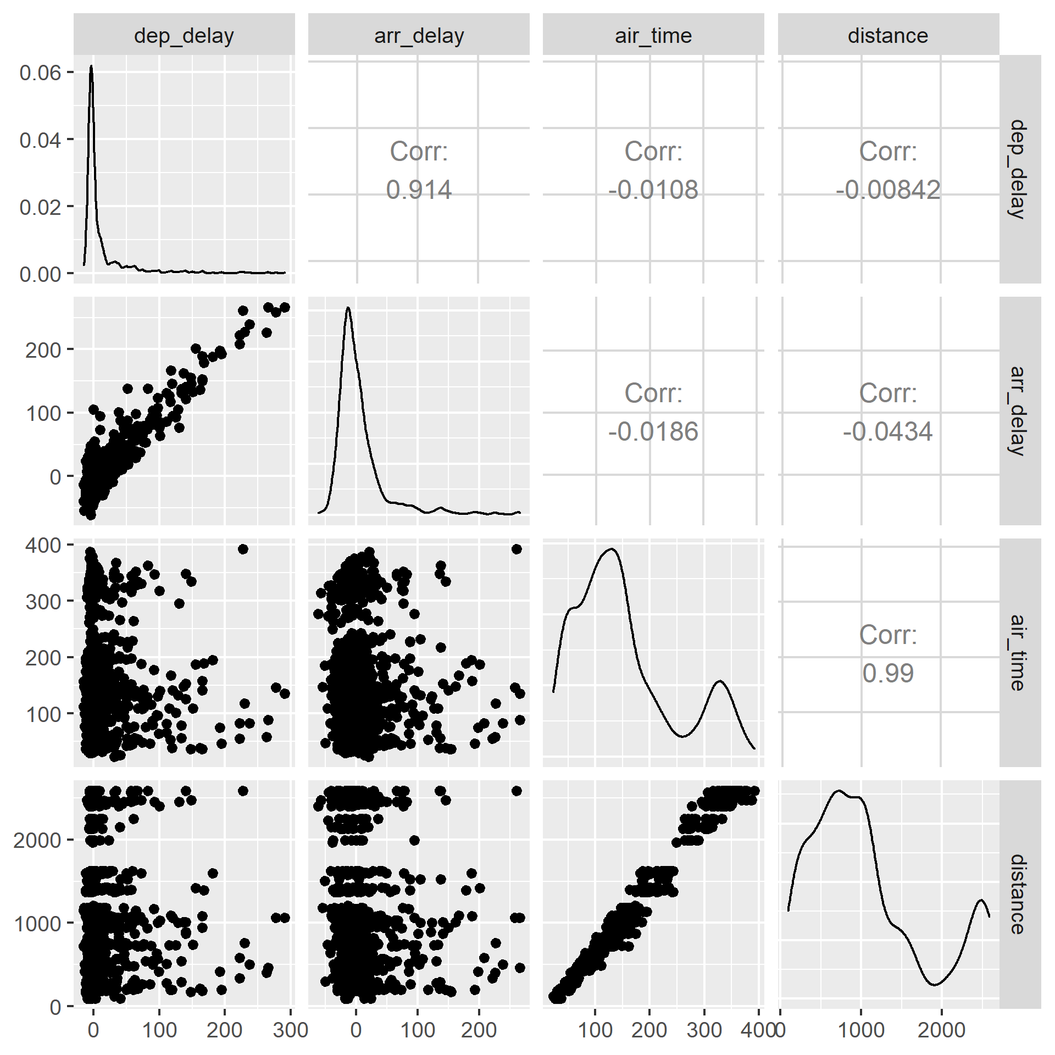
Pairs plot

Slide 69
Pairs plot
Air time and distance correlate strongly
Departure and arrival delay correlate strongly
Air time / distance do not correlate with delay
In other words: distance cannot predict delays well

Slide 70
Conclusion
Exploration is key to understanding things you did not know already
EDA walks a fine line between seeing useful and less useful things (overfitting, if you like)
Some useful principles are:
Peng’s checklist
Understanding what you’re seeing
Finding interesting comparisons
“Straightening and flattening” (using models and residuals)
Standard graphs to look at variation and association

